Slide 1


Introduction to Molecular Biology
Lab 2
Dr. Rawa Abdul Redha Aziz
Ph.D Antibiotics/ Molecular biology

Slide 2
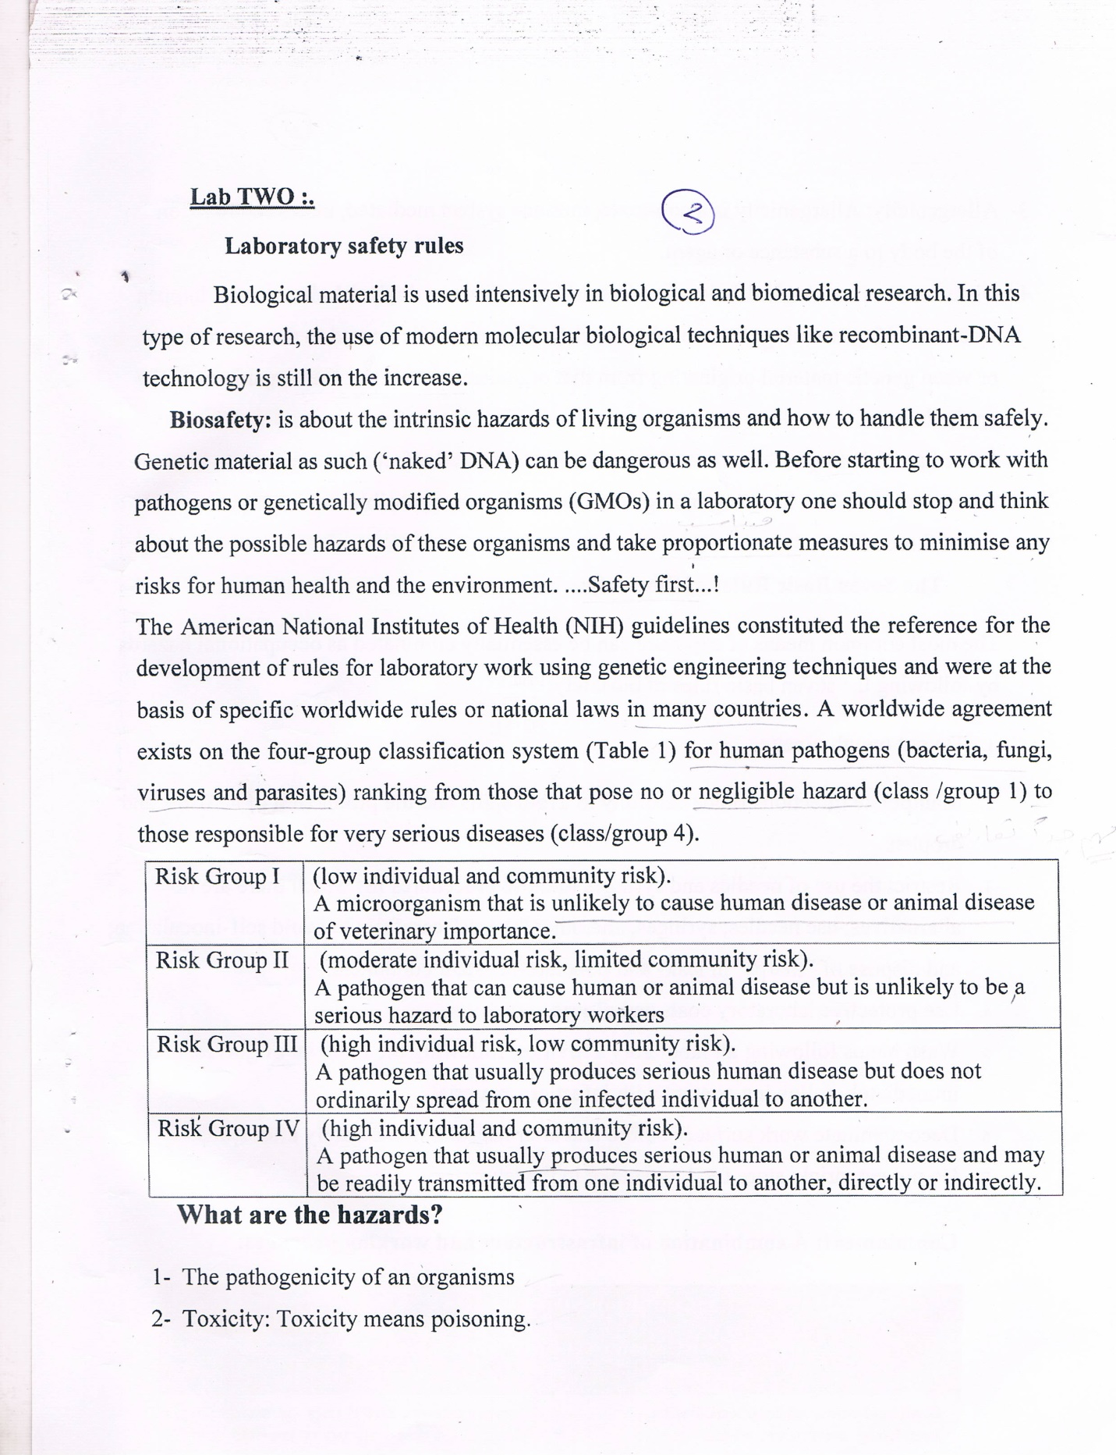

Slide 4
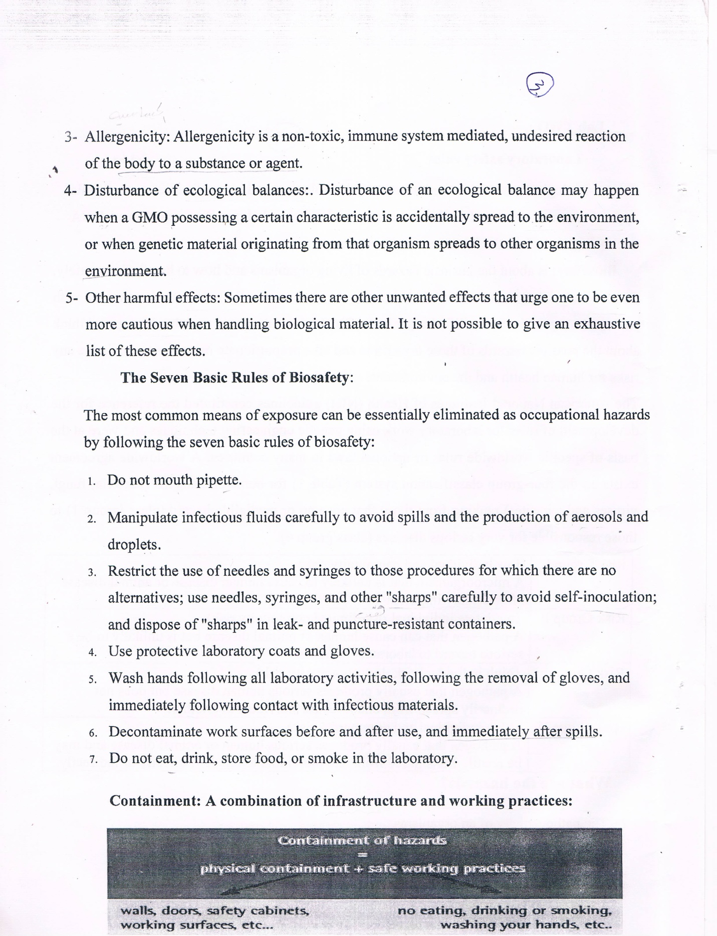

Slide 6
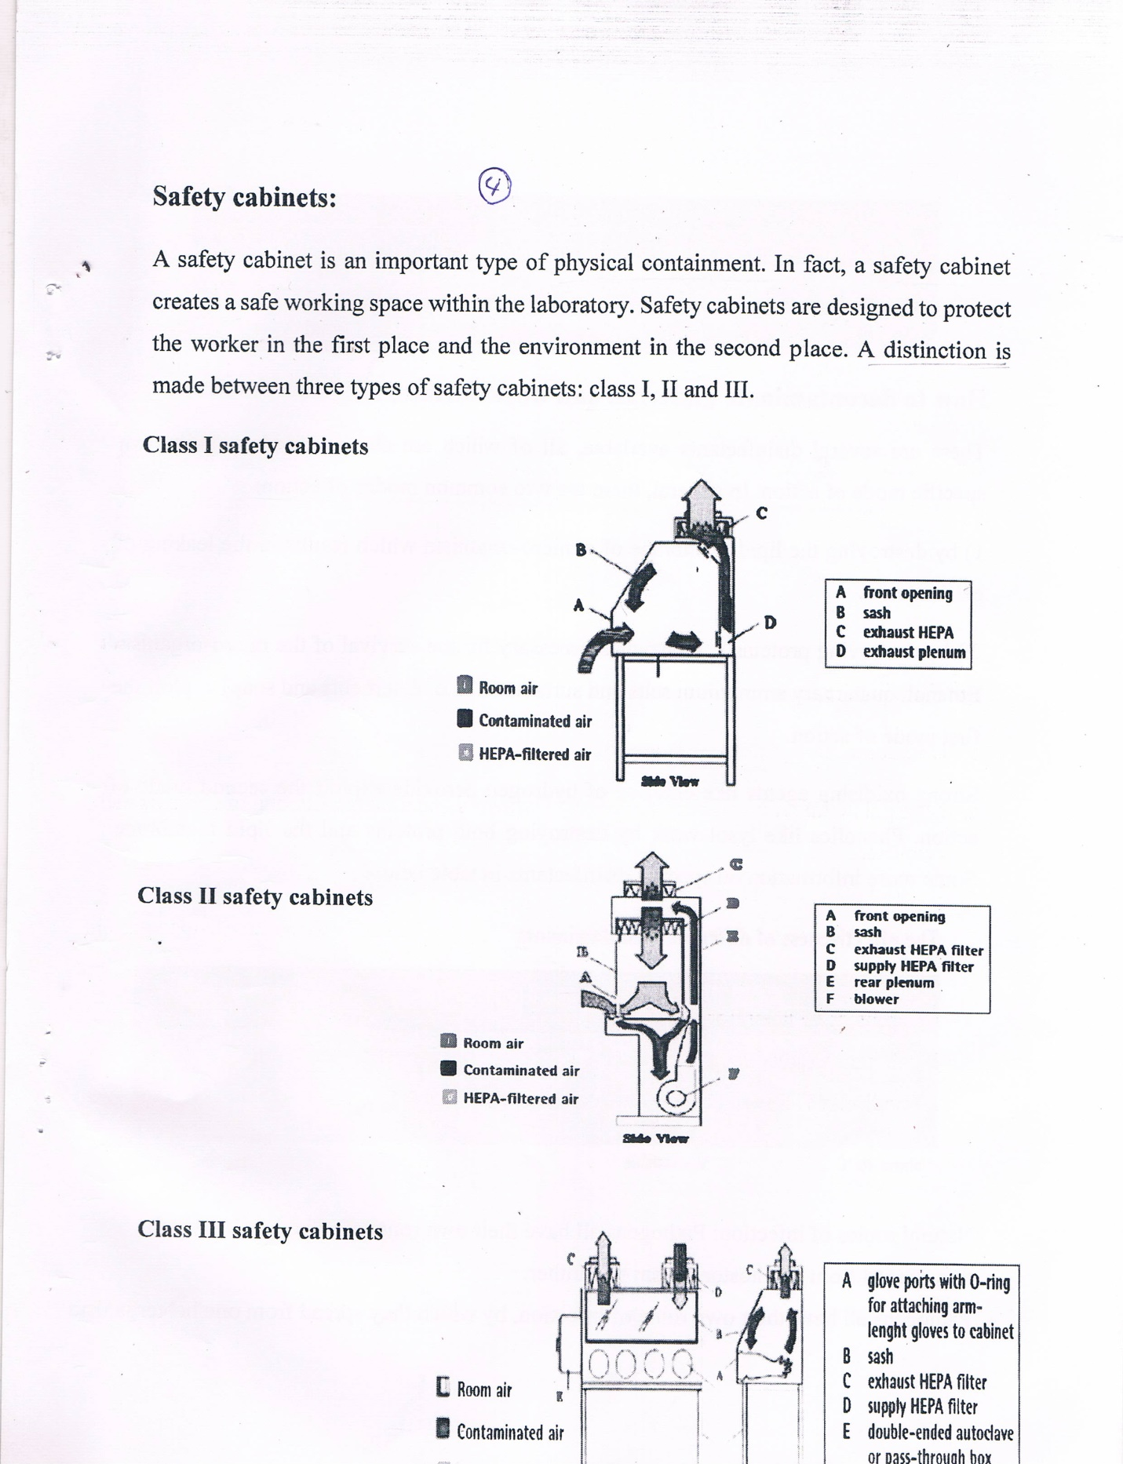

Slide 7
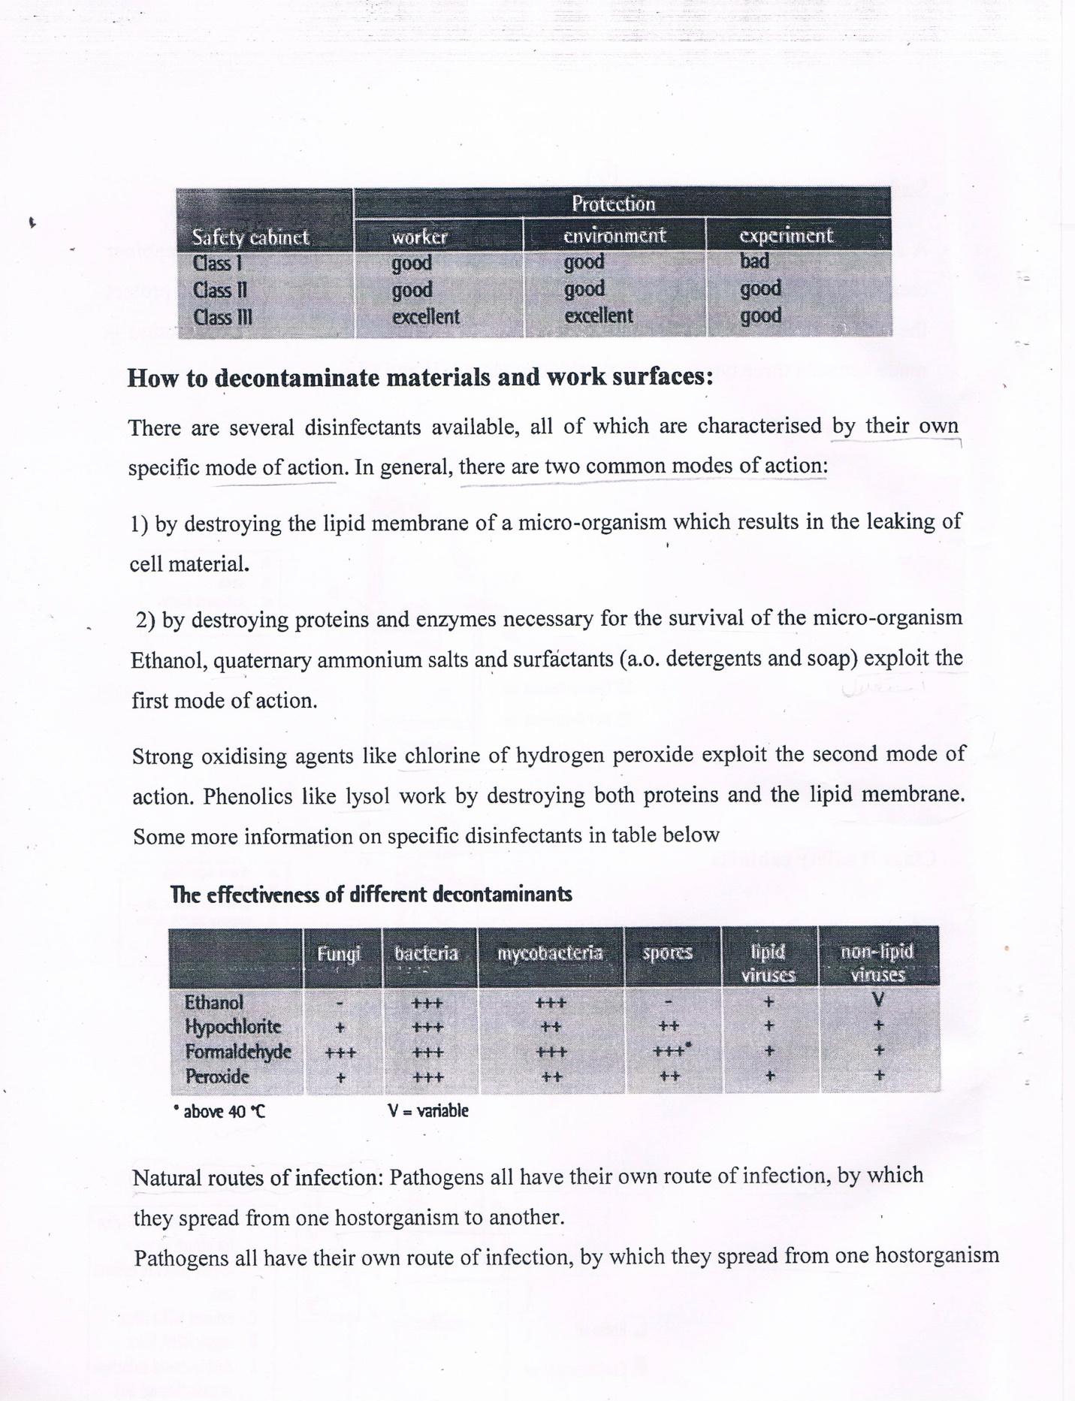

Slide 8
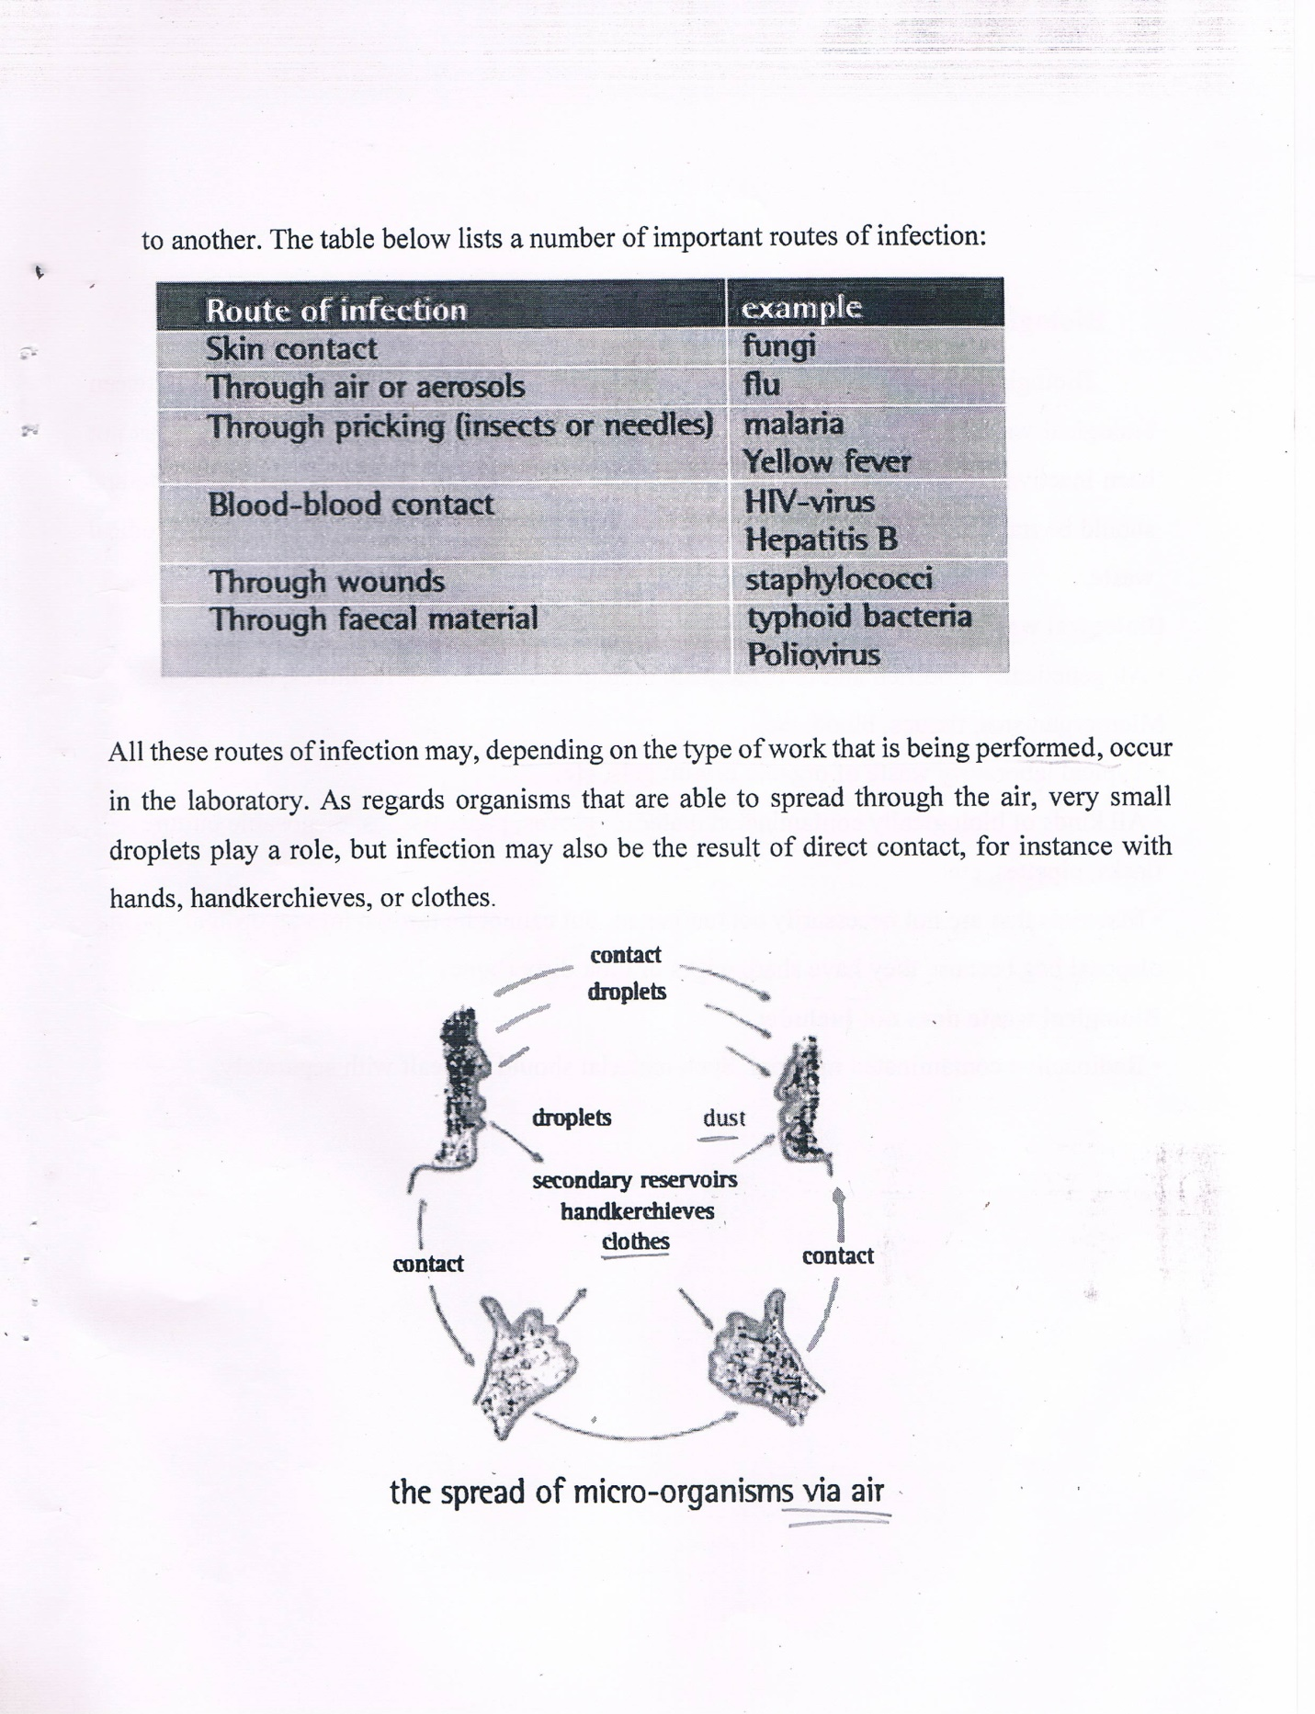

Slide 9
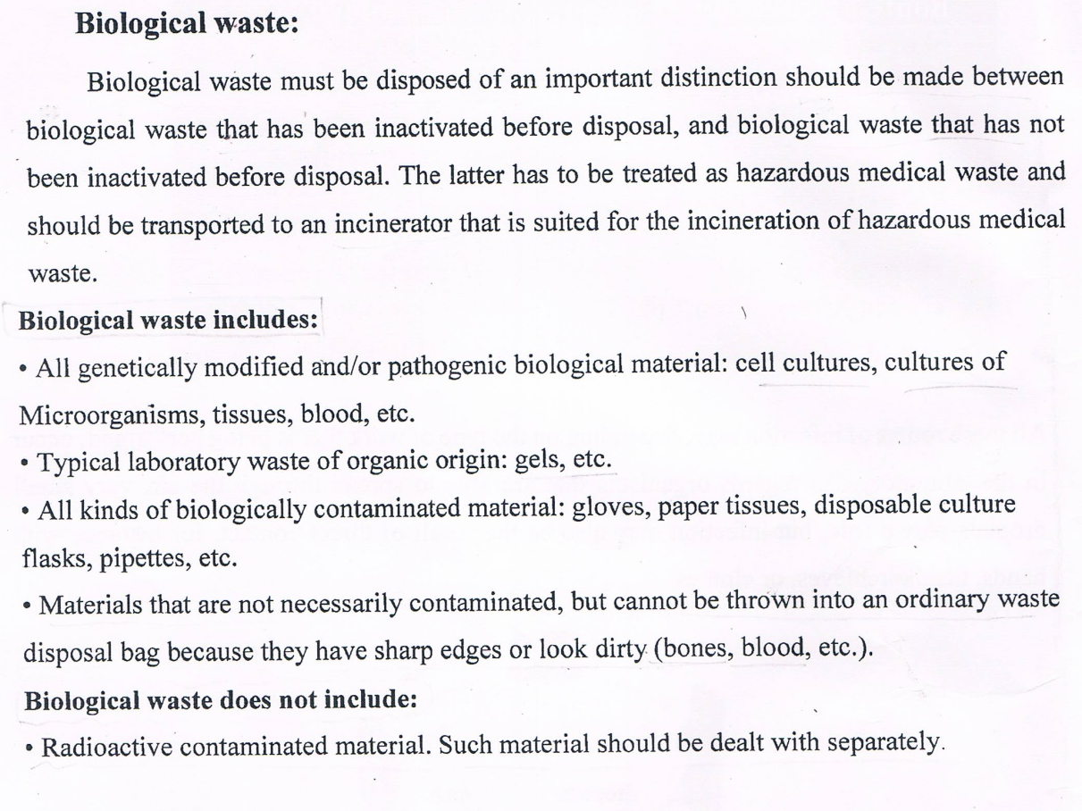

Slide 10

Any Question?

